Slide 1
COMP220: SOFTWARE DEVELOPMENT TOOLS
COMP285: COMPUTER AIDED SOFTWARE DEVELOPMENT
Sebastian Coope Room LG18
coopes@liverpool.ac.uk
All Materials are on Vital
COMP 285/220
© University of Liverpool
slide <number>
Notes:
<Program Title>

Slide 2
Delivery
Lectures
  3 Hours/week
Tutorials
  1 Hour week
COMP220/285
© University of Liverpool
slide <number>
Notes:
<Program Title>

Slide 3
Assessments
COMP220
  80% written examination
  20% continuous assessment:
  Class Test (1 hour during a lecture)
  Lab Test (2 hours: one lab session + 1 additional hour),
COMP285
  50% Lab Test (same as for COMP220)
  50% Practical Assignment (only for COMP285)
COMP220/285
© University of Liverpool
slide <number>
Notes:
<Program Title>

Slide 4
Module aims
To explore software development tools and new methodologies of Software Development
To examine the techniques for implementing some Extreme Programming practices such as
Automated Testing,
Continuous Integration and
Test Driven Programming
To provide an insight into Eclipse (Integrated Development Environment)
COMP220/285
© University of Liverpool
slide <number>
Notes:
<Program Title>

Slide 5
Contents
Methodology of Extreme Programming
  (brief, methodological part)
Software testing theory and practice
Introduction to software tools
Source code control
Java Development with Eclipse
Ant (the main tool considered in this course)
Junit (this is the main, technical part of the course)
COMP220/285
© University of Liverpool
slide <number>
Notes:
<Program Title>

Slide 6
Recommended texts
Java Development with Ant – E. Hatcher & S.Loughran. Manning Publications, 2003 (ISBN:1-930110-58-8)
Ant in Action, Second Edition of Java Development with Ant Steve Loughran and Erik Hatcher
July, 2007 (ISBN: 1-932394-80-X)
Eclipse in Action, A Guide for Java Developers, – D.Gallardo, E.Burnette, & R.McGovern. Manning Publications, 2003 (ISBN:1-930110-96-0)
JUnit in Action, Second edition(!! For New version of JUnit (4); Old version of JUnit 3 will not be considered. ), P. Tahchiev, F. Leme, V. Massol, G. Gregory, Manning Publications, 2011. (ISBN: 9781935182023)
COMP220/285
© University of Liverpool
slide <number>
Notes:
<Program Title>

Slide 7
Extra reading
Java Tools for Extreme Programming – R.Hightower & N.Lesiecki. Wiley, 2002 (ISBN:0-471-20708-X)
Professional Java Tools for Extreme Programming – R.Hightower et al. Wiley, 2004 (ISBN:0-7645-5617-7)
Test Driven Development – K.Beck. Addison-Wesley, 2003 (ISBN:0-321-14653-0)
COMP220/285
© University of Liverpool
slide <number>

Slide 8
Lab sessions
Labs will be devoted to simple exercises helping to really understand how the software development tools (discussed on lectures) work in practice
Inseparable from the lectures
The best and easiest way to prepare to the Exam and Class Test (for COMP220) during the semester
Without doing labs well you will be unable to do and pass Lab Test (for both COMP220 and COMP285).
COMP285 will have additional Practical Assignment and no exam. Thus, labs are invaluable for you
COMP220/285
© University of Liverpool
slide <number>
Notes:
<Program Title>

Slide 9
Schedule
Week 1
  Introduction to Software Tools and Agile and test driven development
Week 2
  Introduction to Eclipse and
Week 3
  Testing theory and practise
Week 4
  Eclipse and JUnit
COMP220/285
© University of Liverpool
slide <number>

Slide 10
Schedule
Week 5, 6, 7 and 8
  Ant and Junit
Week 9
  Issues tracking
Week 10
  Revision
COMP220/285
© University of Liverpool
slide <number>

Slide 11
Lecture 1
Introduction to CASE tools
Why bother?
What types?
How they work in practise?
COMP220/285
© University of Liverpool
slide <number>

Slide 12
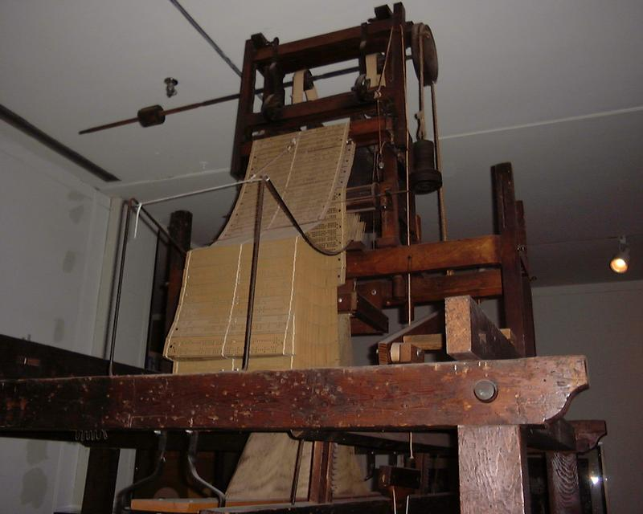
Computer Aided Software Engineering
Well what would be Software Engineering without computers?
COMP220/285
© University of Liverpool
slide <number>

Slide 13
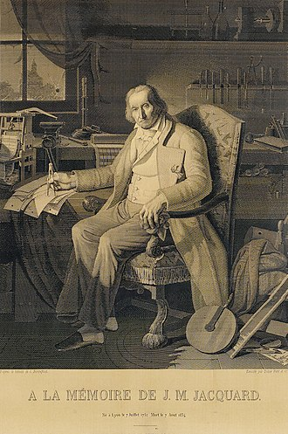
Output
COMP220/285
© University of Liverpool
slide <number>

Slide 14
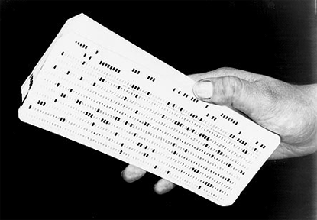
Early days
Software Engineering Stone Age style
  All programs verified by hand
COMP220/285
© University of Liverpool
slide <number>

Slide 15
Early days
Code written in machine code
Not enough memory for debug code addition
CPU time too slow for debugger
No compile stage, so 1 mistake often means program just has fatal crash
Limited output display
COMP220/285
© University of Liverpool
slide <number>

Slide 16
CASE definition
“Computer-aided software engineering (CASE) is the application of computer-assisted tools and methods in software development to ensure a high-quality and defect-free software.”
CASE tools can be
  General purpose, example build/test tools (language neutral)
  Specialist e.g. Load testing/DoS tool like Low Orbit Ion Cannon
  Built yourself (test harness)
COMP220/285
© University of Liverpool
slide <number>

Slide 17
Are these tools
High Level Language Compilers/Interpreters
Object Relational Management software
  Example Hibernate
Profilers
Debuggers
Code analysers
COMP220/285
© University of Liverpool
slide <number>

Slide 18
Why tools?
Would you hire a building company who used?
  No power tools (productivity cost)
  No measuring instruments (accuracy)
  No spirit levels or electrical testing tools (quality)
  Proper scaffolding/access control (safety)
With software, these issues also matter
  Productivity, accuracy, quality, safety
COMP220/285
© University of Liverpool
slide <number>

Slide 19
Why use CASE?
Used properly
  You will become a better software engineer
  You will work better with others
  Your code will be tested more
  You will do things, you wouldn’t normally bother to do (e.g. re-factoring code)
  Your life as a software engineering will be slightly less stressful
COMP220/285
© University of Liverpool
slide <number>

Slide 20
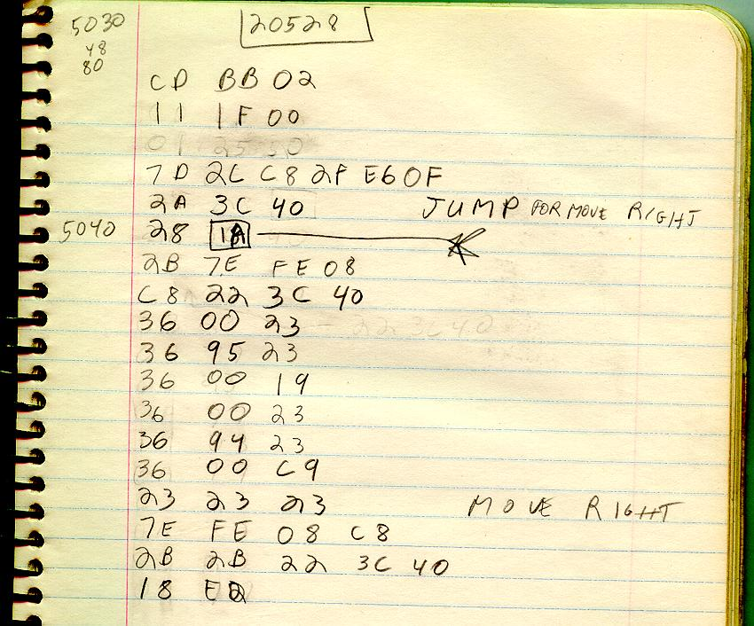
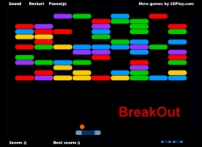
Think of CASE as a series of developments
Machine language (no real CASE)
Seb 1983 Apple II
COMP220/285
© University of Liverpool
slide <number>

Slide 21
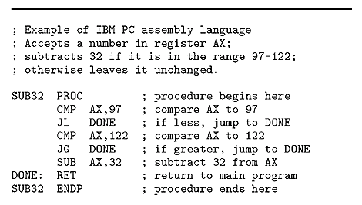
Assembly language
Simple case tool called an assembler translates to machine code, 1 to 1 relation to machine code
No type check, complex data types, all abstraction in programmers head
COMP220/285
© University of Liverpool
slide <number>

Slide 22
High Level Language Compilers
Translate from abstract (non machine language) to machine language of intermediary code
Abstractions are constructed as part of the language, e.g. int, long, String, Person, BankManager
Code is capable of
  Being structured
  Being tested as part of compilation
COMP220/285
© University of Liverpool
slide <number>

Slide 23
Interpreters
Programs which run programs, like JVM for Java (Forth, Basic)
Interpreters can be
  Source code based (execute the code directly) e.g. Java script interpreters
    Fast turnaround time, no-precompile check, only checks running code
  Intermediary code based
    e.g. Java byte code, slower turnaround, supports pre-compile check
COMP220/285
© University of Liverpool
slide <number>

Slide 24
Interpreter features
Program can be debugged by facilities in JVM
JVM can run time check code for
  Errors (array out of bounds)
  Type conversion issues
Garbage collection (contentious, see iOS debate)
JVM can be ported to different hardware, making object code portable
COMP220/285
© University of Liverpool
slide <number>

Slide 25
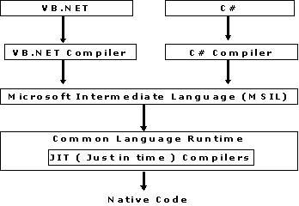
Intermediary code systems
Allows for multiple languages to easily integrate, parts of code can be written in language of choice
Good or bad thing?
COMP220/285
© University of Liverpool
slide <number>

Slide 26
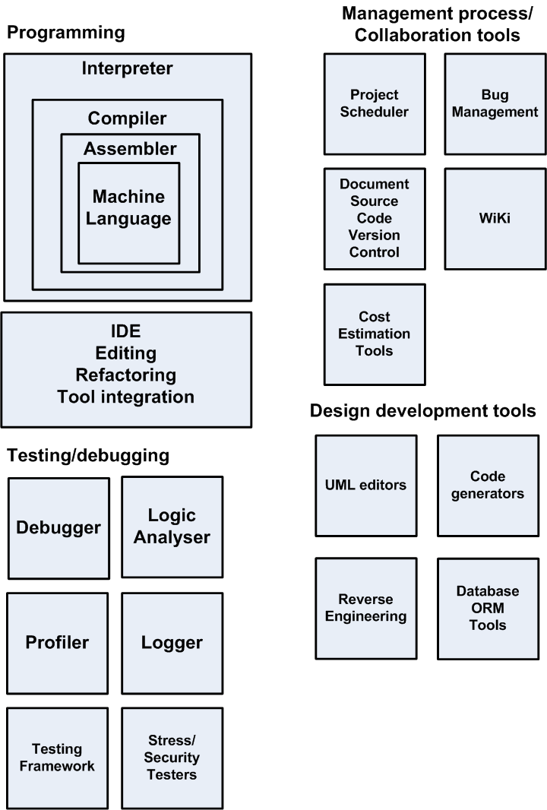
CASE in perspective
COMP220/285
© University of Liverpool
slide <number>

Slide 27
Development IDEs
General purpose
  Eclipse (Java, C, C#, C++) etc
Specialist
  PHP Storm
Benefits
  Improves productivity
  Code generation
  Integrated debugging
  Re-factoring
  Integration with other tools
COMP220/285
© University of Liverpool
slide <number>

Slide 28
Some case tools
Software Debugger
  Allows for
    Program to be stepped
    Variables to be examined
    Reading of stack
    Inspect event listeners
  Focused on specific programming languages
    JavaScript in Chrome (can run via remote cable to Android)
    Java debugger in Eclipse
COMP220/285
© University of Liverpool
slide <number>

Slide 29


In circuit emulator
Does all functions of software debugger but at machine instruction level
ICE replaces CPU in target motherboard
Very useful for embedded debugging e.g. smartphone, DVD player etc.
ICE
CPU socket
COMP220/285
© University of Liverpool
slide <number>

Slide 30
ICE features
Breakpoint before instruction execution
Breakpoint on complex conditions
  Write particular data value to memory location
  Write/read from I/O
  Hardware interrupt
Difference to software debugger
  Faster (runs at full CPU speed)
  Can break on a full range of hardware conditions at the CPU level (example register access)
COMP220/285
© University of Liverpool
slide <number>

Slide 31

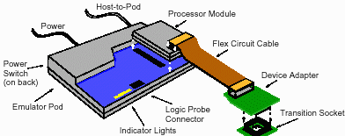
ICE example
COMP220/285
© University of Liverpool
slide <number>

Slide 32
ICE tracing
Instruction trace
  The ICE can record all the instructions executed up to the breakpoint (how we got here)
Jump trace
  The ICE can trace all flow of control instructions going to a certain point
COMP220/285
© University of Liverpool
slide <number>

Slide 33
Logic analyser
Does not need to emulate CPU
Can work with any CPU or circuit that probe can connect to
Can read all hardware activity
Read only
Data+address info
Host machine
CPU
Probe
Machine code + source code here
CPU socket
COMP220/285
© University of Liverpool
slide <number>

Slide 34
Logic analyser
Can
  Take snapshot of code execution include with trace of code (define usually by break condition)
  Run the code at full speed
  Not require debug code added
  Debug race conditions (speed sensitive)
  Monitor hardware/software interaction
  Decompile the code to original C/C++ if source code loaded into target
  Debug hardware + software
COMP220/285
© University of Liverpool
slide <number>

Slide 35
Logic analyser
Cannot
  Step sopt and then step code line by line (code has already executed)
Can
  Allows the host emulator to emulate the code execution after it has finished execution
Can
  Be connected to any part of the hardware DMA, network card, external bus (USB e.g.)
COMP220/285
© University of Liverpool
slide <number>

Slide 36

Kernel mode soft debugging
Same functions as ICE but uses debug features of CPU, driver loaded into OS
Can be used to debug device drivers
Examples
  Windbug kernel mode for windows
Debug console
Target
machine
COMP220/285
© University of Liverpool
slide <number>

Slide 37
Profiler
Calculates how much
  Time is used by different parts of your code
  Memory is used by different parts of code
Useful for
  Code optimization for
    Faster code
    Code to use smaller memory footprint
COMP220/285
© University of Liverpool
slide <number>

Slide 38
Logger
Used to record all activities of program
Logged can record activity to
  File
  Database
  Email account
Can be used for
  Security logging (e.g. everytime bad password)
  Financial logging (everytime a credit card is used)
  Debug logging (entry and exit to methods)
COMP220/285
© University of Liverpool
slide <number>

Slide 39
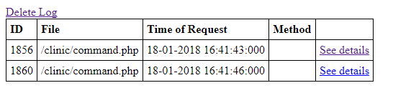
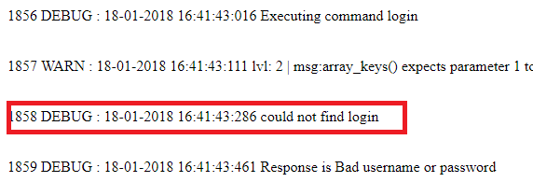
Logger
In code…
  trace ('could not find login',Logger::DEBUG);
On screen: (http://test.dunes-software.com:81/clinic/trace.php)
COMP220/285
© University of Liverpool
slide <number>

Slide 40
Testing Frameworks
Junit
  Allows for testing of code and production of test reports
  Integrated for Eclipse in form of Junit Wizard and plug
PHP Unit
  Same for PHP
All use assertions to test if code is correct
Using testing framework is important part of Test Driven Development (see next lecture)
COMP220/285
© University of Liverpool
slide <number>

Slide 41
Stress Testing tools
Mysqlslap
  Sends heavy load to MySQL server
Website load testing tools
  Many choices (LOIC simple, Neoload (more complex)
  Have to be able to simulate complex real transactions (not just send random traffic)
Benefits
  Optimise the performance of website
  Determine maximum user load
  Determine what happens when system reaches heavy load
COMP220/285
© University of Liverpool
slide <number>

Slide 42
Code development tools
Code translators
  Example Java to JavaScript
  Jsweet (http://www.jsweet.org)
  Support for browser DOM objects like
    Writing to fields in webpage
    Support for HTML canvas
  The whole web app active code can be written in Java
  Example code is here:
  http://cgi.csc.liv.ac.uk/~coopes/dokuwiki/doku.php?id=jsweet
COMP220/285
© University of Liverpool
slide <number>

Slide 43
Benefits of Cross compiling
Have single code base for project
  So encryption algorithm server side can be cross compiled to equivalent code for client side
Use higher level language
  Java supports type checking (not in JavaScript), private, final, interface definitions
  Can use Java libraries (if cross compiled)
  Can use Java programmers
COMP220/285
© University of Liverpool
slide <number>

Slide 44
Project management tools
Zoho
  https://www.zoho.eu/projects/
  Online co-ordinate group project activitiy
  (includes scheduling, charts, issue tracking)
Bug management/issue tracking
  Active online database for tracking and chasing bugs
WiKi
  Easy to edit website (good for general system documentation)
COMP220/285
© University of Liverpool
slide <number>

Slide 45
Cost Estimation tools
Some tools developed for Cocomo
Agile
  Uses poker planning cost estimation
  Not many software tools used for this, is mostly a manual process
COMP220/285
© University of Liverpool
slide <number>

Slide 46
Version document control
Allows
  To keep all old versions of files
  To allow more than 1 person to change a file at the same time and merge results
  To provide access to old versions
  To be able to track changes to files
Examples
  svn, git
Note
  All documents need some kind of version control
COMP220/285
© University of Liverpool
slide <number>

Slide 47
UML editors
Tools to allow UML diagrams to be produced electronically
Benefits
  Higher quality diagrams
  Allows hierarchical diagram linking
  Things like class diagrams can be used to generate code automatically
Examples
  Argo UML, Rational Rose, Papyrus (Eclipse plug-in)
COMP220/285
© University of Liverpool
slide <number>

Slide 48
Reverse engineering
Takes object code and converts to source code
Used to
  Determine how product works
  Determine if code is infringing IPR
  Hack in, break copy protection
Examples
  JD Project (Java decompiler) http://jd.benow.ca/
  Disassembler (simplistic)
  C decompilers
Process needs symbols lists to make sense of code
COMP220/285
© University of Liverpool
slide <number>

Slide 49
ORM relational manangement
Used to save objects directly to database with programmer having to write MySQL statements
Benefits
  Saves programming time
  Reduces MySQL errors
  Improves performance (code can include performance enhances such as sharding)
  Allows validation of parameters such as database table names
COMP220/285
© University of Liverpool
slide <number>

Slide 50
ORM Examples
Hibernate (Java based)
nHiberante (C# based)
Example class…
public class Stock implements java.io.Serializable {
private Integer stockId;
private String stockCode;
private String stockName;
private StockDetail stockDetail;
//constructor & getter and setter methods
}
COMP220/285
© University of Liverpool
slide <number>

Slide 51
ORM example code
<hibernate-mapping>
<class name="com.mkyong.stock.Stock" table="stock" catalog="mkyongdb">
<id name="stockId" type="java.lang.Integer">
<column name="STOCK_ID" />
<generator class="identity" />
</id>
<property name="stockCode" type="string">
<column name="STOCK_CODE" length="10" not-null="true" unique="true" />
</property>
<property name="stockName" type="string">
<column name="STOCK_NAME" length="20" not-null="true" unique="true" />
</property>
<one-to-one name="stockDetail" class="com.mkyong.stock.StockDetail"
cascade="save-update"></one-to-one>
</class>
</hibernate-mapping>
COMP220/285
© University of Liverpool
slide <number>

Slide 52
Processes with/without case
No CASE
  Tester sends bug report to programmer via email, programmer looks at code, fixes code, sends new source back to tester
Problems
  No proper record of bug and fix
  Visibility of process limited (team leader manager)
  Easy for bugs to get lost
  Hard to but priority on bug
COMP220/285
© University of Liverpool
slide <number>

Slide 53
Bug fix with CASE
Tested finds bug and records on bug management tool (example Bugzilla) and assigns bug to programmer
Bug management tool sends email to programmer
Programmer logs into bug management tool and accepts/rejects bug and adds comment
Programmer updates latest source code from source code control system
Programmer fixes/tests bug using debugger
Programmer re-commits code back to source code control with comment, which links back to bug id
Programmer adds comment from source code control log and comment about how to test bug to bug control system
Team leader downloads all source code and makes new build
COMP220/285
© University of Liverpool
slide <number>

Slide 54
Bug fixing with CASE support
Looks a lot more work, but most of the CASE processes take v.little time
Allows bugs to be properly assigned to staff
Gives a clear view of the process to the management of the project
One can look back and find out which bugs were fixed on which versions of files
Makes sure that bug reports are filled in correctly
COMP220/285
© University of Liverpool
slide <number>

Slide 55
Summary
Using CASE can make you
  Quicker
  Better team working
  More controlled
Many tools to choose from
Using IDE will encourage best practise
We will be looking in more detail at some of these tools in the next lecture
COMP220/285
© University of Liverpool
slide <number>

